Slide 1
Water Quality
Prediction and Classification
Matt Sgueglia, Minh Tao, Max Spieler

Slide 2
Motivation & Research Question
Ensuring that communities are supplied with clean water is essential to general public health.
Through our research, we hope to contribute to the body of knowledge that examines using machine learning methodology to quickly and accurately predict water quality and potability based on a few key measurements and features of a water body. We then we want to see whether we can apply this model to different new datasets with some overlap in features to quickly and accurately predict water potability.
Applications of this would be for quick water quality measurements or cheap and accurate water quality monitoring
Notes:
In the United States, we are lucky to be able to say that we have one of the safest water supplies in the world. According to the CDC, over 90 percent of Americans get their tap water from community systems, which are subject to very specific quality regulations and are tested regularly. However, not all global communities are able to blindly trust the quality of their water supply as Americans do.

Slide 3
Data Sources
Water Potability - Kaggle - Basis Set
Dataset aggregating water quality measurements from 3276 different water bodies
No official sources of measurement listed, but widely used on Kaggle and contains commonly accepted key measures of water quality
Includes measures such as: Temperature, conductivity, hardness, total dissolved solids (TDS), chloramines, sulfates, total organic carbon (TOC), turbidity
Indian Water Quality Data - Kaggle
Combined data for historical water quality in certain locations of India, sourced from research published by the Indian government
Includes measures such as: Temperature, conductivity, pH, biological oxygen demand (BOD), nitrates & nitrites, fecal coliform
…..

Slide 4
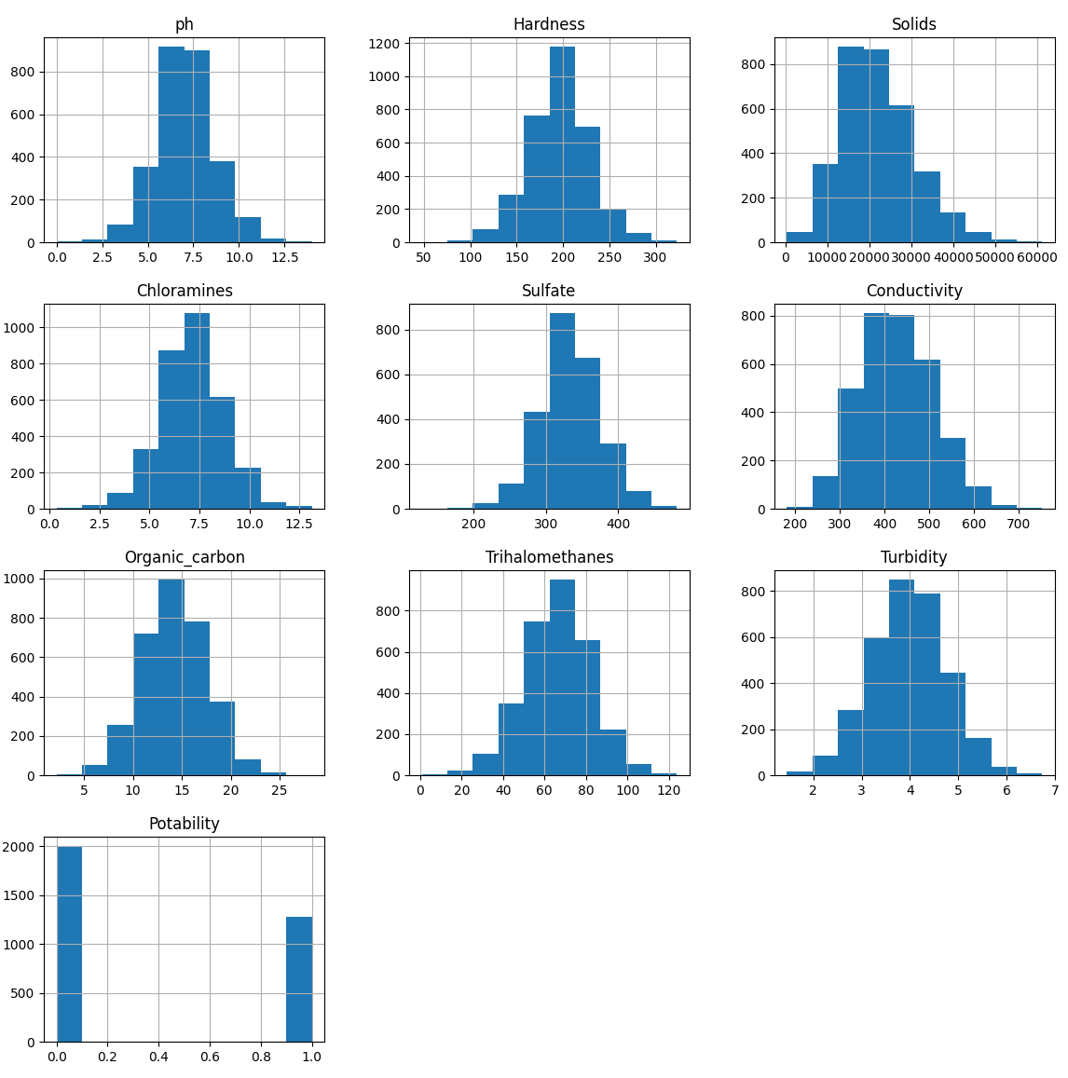
Initial Visualization
Feature | Log_Coefficient
PH | 0.00001
Hardness | -0.001189
Solids | 0.000005
Chloramines | 0.000861
Sulfate | -0.000879
Conductivity | -0.000463
Organic Carbon | -0.002047
Trihalomethanes | 0.00305
Turbidity | 0.000096
Notes:
In order to gain some preliminary insight as to how different variables relate to water quality, we decided to use a LogisticRegression model with a SimpleImputer as a baseline. The coefficients denoting each feature’s importance is displayed here.

Slide 5
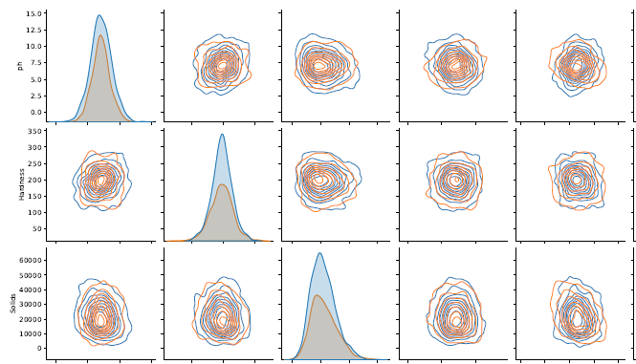

Slide 6
Anticipated Challenges
Consolidation of Disapparate and Different Datasets into Single Framework
Good Imputation of Missing Data Points
Generalizability. Different datasets have different features that only partially overlap
Successful Expansion Beyond Existing ML Research

Slide 7
ML Approach
Considerations:
Small Dataset (~3000 rows, 10 features)
Strong Data overlap
Initial Approach:
Higher dimensional Support Vector Classification Initial = 70% Accuracy
Random Forest Classification Initial = 70% Accuracy
Ensemble learning methods, including boosting

Slide 8
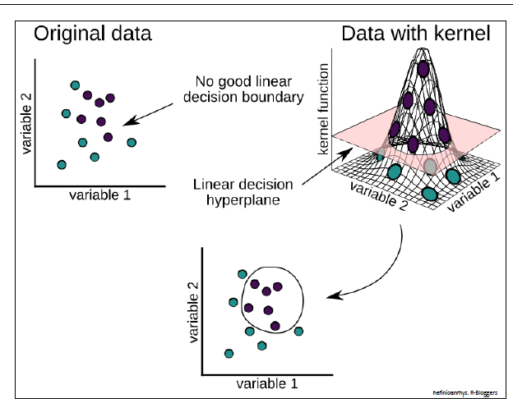
SVC

Slide 9
Timeline
Consolidation, finalization and formalization of methodology
Full Implementation of code and pipeline with only minor remaining refinements
Draft report Write-Up
Iterate on incremental actionable feedback from presentation
Now
Initial Presentation
Progress Update
Draft Report
Final Presentation
Final Report
Data Preprocessing
Data Visualization
Review of Previous Literature
Decision on WQI and WQC calculation, integration, and implementation
Full finalization of visualization, results, and presentation
Full report finalized and ready for sequential review

Slide 10
Q & A

